Slide 1
PREDICTING 2024 us ELECTION
ZUbair Atha | EESHA BARUA | SIBI MARAPPAN | JuSTIN MATHEW | PRANITHA NATARAJEN

Slide 2
Project Overview
This project aims to predict the outcome of the 2024 U.S. presidential election by applying Bayesian modeling techniques to recent polling data and historical election results. This data-driven approach leverages statistical models to combine insights from both current and past data, generating reliable predictions of each candidate’s chances. The presentation covers four key areas:
Data Exploration: An initial analysis of the 2020 election and 2024 polling data, identifying essential trends and observations.
Data Cleaning and Sampling: Steps taken to ensure data consistency and quality, focusing on critical variables and states.
Key Insights: Observations that guide the predictive model and define important variables.
Machine Learning Approach: Implementation of a Bayesian model, a probabilistic approach that dynamically updates with new polling data, providing flexible and adaptive predictions.
Data Sources:
2020 Election Results: State-by-state votes for Trump and Biden from the 2020 election serve as a baseline for understanding recent voting patterns.
FiveThirtyEight Polling Data: Includes active polling data for 2024 and historical data from past elections dating back to 1968, allowing comparisons across time and providing an understanding of current voter sentiment.
Notes:
The project aims to predict the 2024 U.S. presidential election outcome using Bayesian methods that can adapt as more polling data becomes available. This predictive approach uses a combination of historical voting data and real-time polling data to improve accuracy.
We began by analyzing the 2020 election results (2020_election_results_cleaned.csv) to establish baseline voter behavior, including total votes cast, state winners, and electoral votes per state. This historical data serves as the foundation for modeling voting tendencies and understanding where candidates previously excelled.
We utilized 2024 polling data (president_polls.csv and presidential_poll_averages_2020.csv) from FiveThirtyEight to capture current voter sentiment. This data includes key details such as polling dates, sample sizes, and support percentages for each candidate. The dataset also captures pollster ratings, allowing us to weigh polls differently based on quality.
Data cleaning involved handling missing values by imputing medians, especially in numeric columns like support percentages and sample sizes, ensuring consistent data quality. We dropped features such as irrelevant links and identifiers that had no predictive value, focusing instead on critical columns like support percentages, dates, and pollster quality.
Special emphasis was given to swing states during data sampling. These states, identified from the 2020 data, include places like Pennsylvania, Wisconsin, and Michigan—states that have historically shown variability and played decisive roles. By prioritizing polling data from these swing states, we aim to enhance the model's focus on regions most likely to influence the election.
The Bayesian model developed in the notebook uses prior information from the 2020 election and continuously updates based on the current polling data. By varying the polling trust level (weight_poll) in the model, we were able to simulate different scenarios, assessing how different levels of trust in polling data compared to historical data would affect predictions.
Simulations were performed using the simulate_election() function, which took into account the weighted combination of historical votes and polling support, producing probability estimates for electoral outcomes in each state. These simulations gave us insights into the uncertainty inherent in swing states, represented through error bars showing average electoral votes and standard deviations.
The project relies on a combination of data sources—2020 election results to understand historical voting patterns, and current polling data to account for shifting voter preferences. Polling data was further refined by considering pollster ratings and sample sizes, ensuring that low-quality or small-sample polls had minimal impact on the model's outcomes.
The Bayesian approach was chosen to address the unpredictable nature of elections, especially in swing states. By updating predictions dynamically, the model can capture changes in voter behavior influenced by major events such as debates or political campaigns, which are reflected in the polling data.

Slide 3
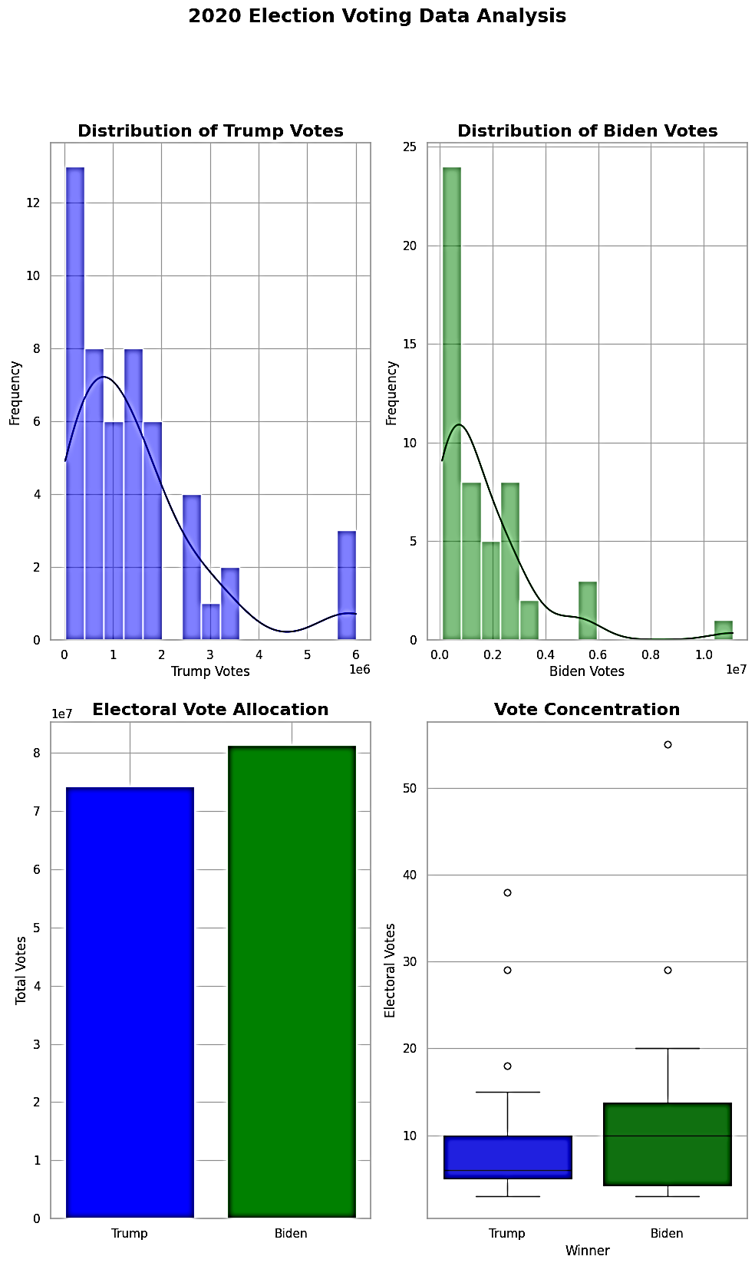
Initial Data Exploration – 2020 Election Results line Data
The 2020 election dataset provides crucial insights into voter behavior in the previous presidential election, offering a foundation for analyzing the 2024 race. Key variables include:
State: Identifies each U.S. state.
Electoral Votes: The number of electoral votes per state.
Total Votes for Trump and Biden: The raw vote count for each candidate.
Winner: Indicates the candidate who won the state in 2020.
Visualizations:
Vote Distribution Histogram: A histogram visualizes the distribution of votes each candidate received across states, highlighting regional differences in support.
Box Plot of Electoral Votes by Winner: This plot shows the concentration of electoral votes won by each candidate, with Biden carrying states with higher electoral totals on average.
Key Takeaways: The 2020 results indicate strong regional trends, with Biden winning in states with higher populations and Trump performing well in traditionally red states. This data provides a baseline understanding of voter behavior, which informs the 2024 prediction model by highlighting historical voting patterns.
Notes:
The 2020 election dataset (2020_election_results_cleaned.csv) provided a basis for understanding voter behavior during the previous election, which is crucial for building the 2024 prediction model.
Key variables included state, electoral votes, total votes for Trump and Biden, and the winner in each state. These variables offered insight into regional voting patterns and the relative influence of each state.
Histograms were used to illustrate the distribution of votes for each candidate, helping to identify where Trump or Biden received substantial support and highlighting differences in turnout across regions.
A box plot was used to show how electoral votes were distributed between Trump and Biden. The plot indicated that Biden performed well in states with higher electoral counts, suggesting he succeeded in more densely populated and electorally important areas.
The analysis revealed strong regional trends: Biden’s victories were concentrated in high-population states, while Trump maintained dominance in traditional red states. These observations are essential for determining which regions are likely to maintain past voting behaviors and which may shift in the next election.
This dataset provided a baseline understanding of voter behavior, forming the "prior" knowledge used in our Bayesian model. By establishing historical voting patterns, we can effectively adjust predictions with new polling data as it becomes available.

Slide 4
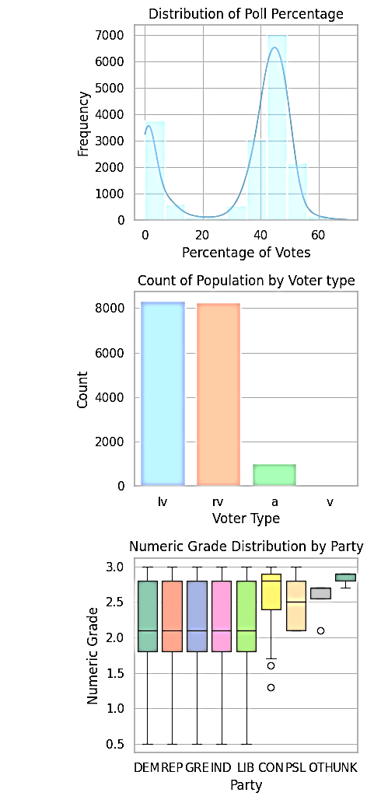
Understanding Current Polling Data
for 2024 Elections
FiveThirtyEight’s active polling dataset offers a snapshot of real-time public opinion in the 2024 election cycle. Key columns in this dataset include:
Pollster: Organization conducting the poll.
Date: Poll date, capturing the recency of the data.
Sample Size: Number of respondents in each poll, impacting the reliability of the results.
Polling Methodology: Method used (e.g., online, phone), affecting the sample’s representativeness.
Population Type: Differentiates between “likely voters” and “registered voters,” which affects data reliability.
Candidate Support Percentages: Percentages of respondents supporting each candidate.
Visualizations:
Distribution of Poll Percentages: This histogram highlights the variability of candidate support percentages across states.
Population by Voter Type: Visualizes the distribution of voter types, which affects poll reliability and accuracy. (lv=likely voters, rv=registered voters, a=adults, v=voters)
Pollster Quality by Party: A box plot comparing pollster reliability ratings across parties.
Key Insight: Polling data shows considerable variability, with polls from high-rated pollsters being more reliable. High sample sizes and reputable polling methods are critical, as they provide data with lower margins of error, essential for building accurate predictions.
Notes:
The 2024 polling data was obtained from FiveThirtyEight, using president_polls.csv and presidential_general_averages.csv. These datasets helped refine our model by incorporating up-to-date polling trends from the ongoing election cycle.
Key features included pollster ratings, sample sizes, polling dates, and support percentages for candidates. These allowed us to gauge voter sentiment and evaluate poll reliability.
Polls were filtered based on pollster ratings, ensuring only high-quality data was used, reducing bias in the model.
Missing values in critical fields like support percentages were handled through median imputation, preserving data quality. Irrelevant columns were removed for efficiency.
We emphasized polling data from swing states like Pennsylvania, Wisconsin, and Michigan, identified from the 2020 election dataset (2020_election_results_cleaned.csv) as key battlegrounds. This focus allowed us to capture critical shifts in these unpredictable regions.
Polls were weighted by sample size to give larger, statistically stronger samples greater influence, improving prediction accuracy.
The 2024 polling data was used as the "likelihood" in our Bayesian inference model, updating the "priors" derived from the 2020 election results. This integration allowed the model to adjust dynamically, adapting as new polling data was introduced.

Slide 5
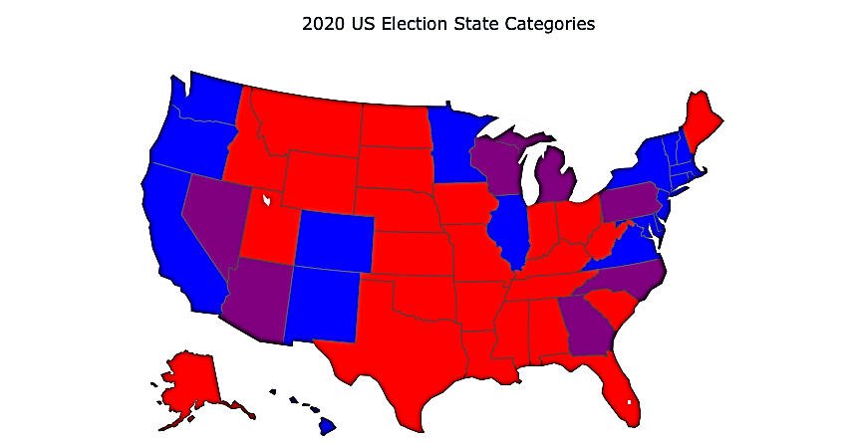
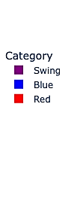
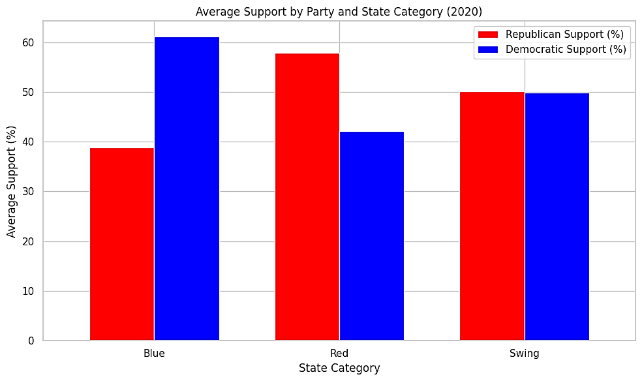
Historical Polling Trends (1968-2020)
The historical polling dataset spans from 1968 to 2020, offering a longitudinal perspective on political trends across different categories of states.
Visualization:
U.S. State Map with Colour Coding by Political Category: Swing states in purple, red states in red, blue states in blue.
Bar Chart of Historical Trends by State Category: This chart shows average polling support for each party within swing, blue, and red states across recent elections, providing a historical context for current trends.
Observations:
Blue (traditionally Democratic) and red states (traditionally Republican) are consistent, holding steady for their respective parties in 2024.
Swing states show substantial variability in voting patterns and frequent shifts in party support, which means we need for a model that adapts dynamically to recent polling data.
Key Takeaway: While blue and red states generally maintain historical voting trends, swing states’ variability makes them central to our prediction model. This insight helps determine weight distributions between historical and recent data in the Bayesian model.
Notes:
The historical polling dataset from 1968 to 2020 (pres_pollaverages_1968-2016.csv) was used to analyze long-term political behavior across states. This dataset provided insights into voter consistency and allowed us to classify states into red, blue, and swing categories.
We visualized this classification using a U.S. state map with color coding: purple for swing states, red for Republican states, and blue for Democratic states. This visualization highlighted which regions have consistently supported the same party and which have shown shifts over time.
A bar chart was also created to show average polling support for each party within swing, blue, and red states across recent elections. This visualization highlighted the difference between consistent party support in blue and red states versus the variability seen in swing states.
The analysis showed that blue and red states maintained steady support for their respective parties, while swing states demonstrated significant variability. In the Bayesian model, this variability led to different weight distributions: blue and red states relied more heavily on historical data, while swing states depended more on recent polling data.

Slide 6
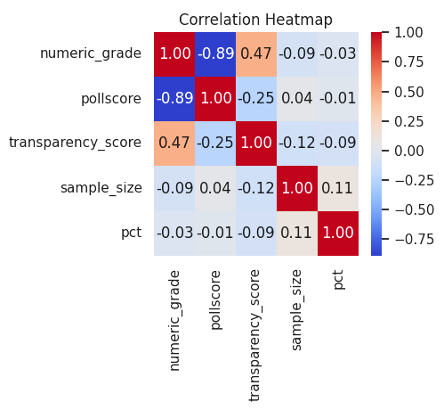
Data Cleaning and Feature Transformation
To ensure a reliable predictive model, data cleaning and sampling were undertaken to enhance data quality:
Feature Reduction: Irrelevant or redundant columns (e.g., URLs, identifiers) were removed, focusing on features with a direct impact on predictions.
Handling Missing Data: Missing numeric values (e.g., poll score, sample size) were filled with median values to maintain dataset integrity.
Sampling Strategy: High-quality polling data from swing states received priority in sampling, as these states are likely to impact the final outcome more significantly.
Visualization:
Correlation Heatmap of Key Numeric Features: This heatmap reveals strong correlations between variables such as polling scores, transparency scores, and sample size, helping to inform which variables are prioritized in the model underscoring the importance of high-quality polls for reliability
Key Takeaway: By cleaning and sampling the data to focus on high-quality, relevant features, we reduce noise and improve the model’s ability to make accurate predictions.
Notes:
Data cleaning and sampling were undertaken to improve the quality of the dataset for reliable modeling.
Feature Reduction involved dropping irrelevant or redundant columns such as URLs and identifiers. Only features with a direct impact on the model's predictions were kept to minimize complexity and improve efficiency.
Missing values in numerical columns like polling scores and sample sizes were handled using median imputation. This ensured that data consistency was maintained without skewing results with outliers.
A stratified strategy was employed to prioritize high-quality polling data, especially from swing states, as they were crucial due to their historical variability, making them essential for understanding shifts in voter sentiment. Polls from highly rated pollsters were weighted more heavily to ensure reliability.
A correlation heatmap was generated to examine relationships between numeric features such as polling scores, transparency scores, and sample sizes. This heatmap helped identify strong correlations and guided which features should be prioritized for accurate prediction.

Slide 7
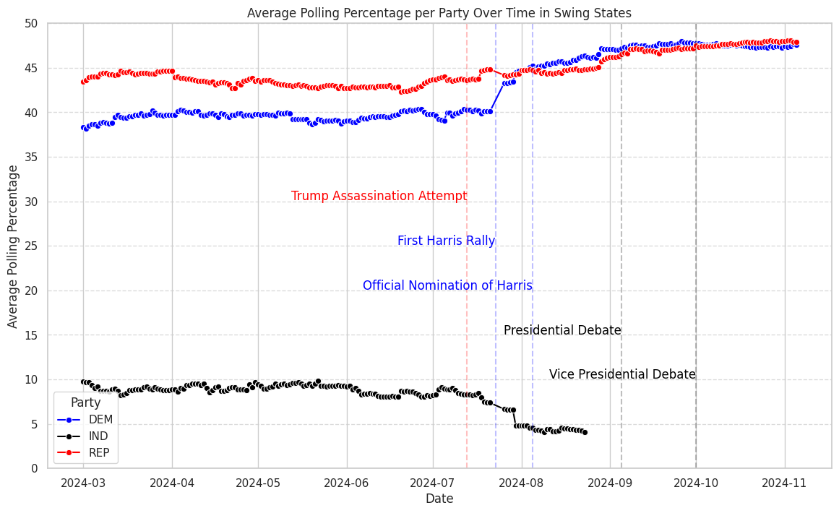
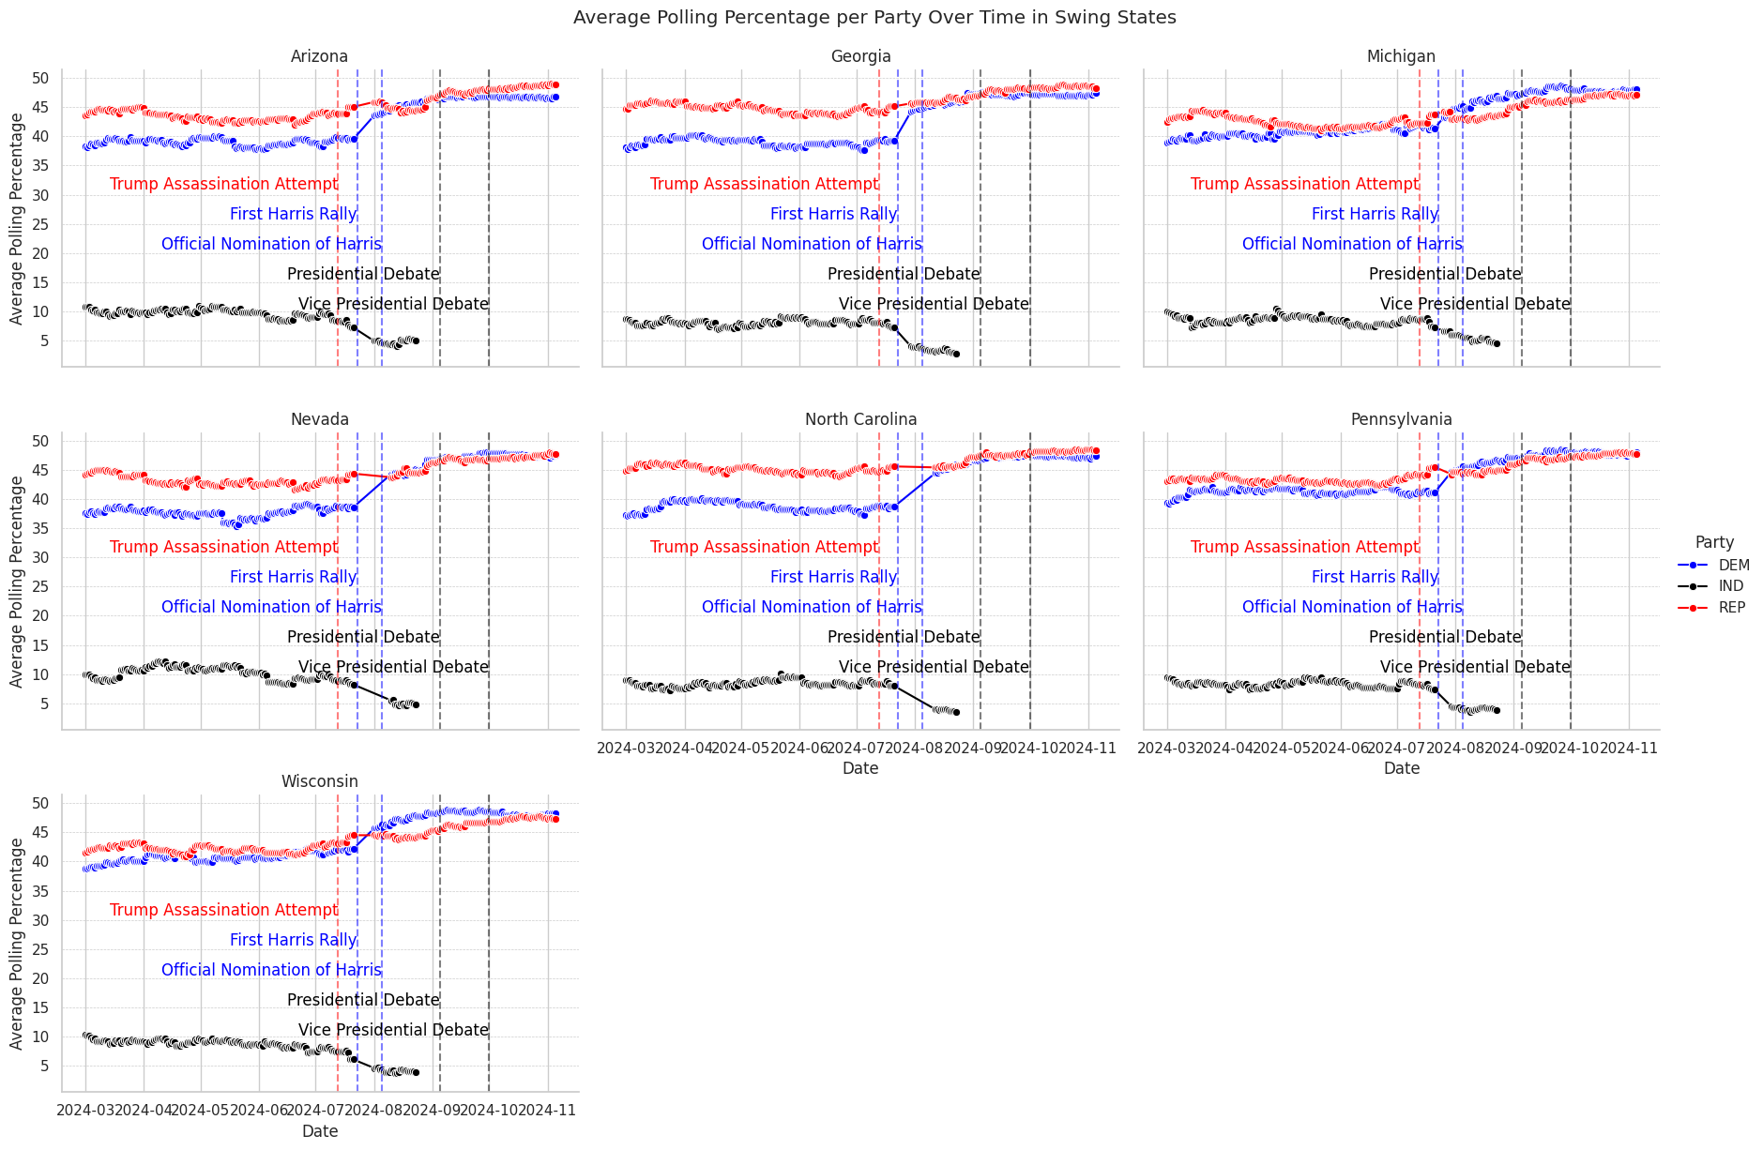
Polling Trends in Swing States
Swing states are crucial to this analysis due to their history of variable election outcomes. For 2024, the focus is on states that are expected to be highly competitive: Pennsylvania, Wisconsin, Michigan, Georgia, Arizona, Nevada, and North Carolina.
Findings:
Swing states show closely contested polling, with slight fluctuations reflecting high voter engagement and event sensitivity.
The correlation between estimated and adjusted poll scores in swing states is strong at 0.995, suggesting that adjusted scores are highly reliable and help counter polling biases.
Visualization:
Time Series Line Chart of Polling Trends Over Time in Swing States: This line chart tracks each candidate’s polling percentages over time, with markers for significant events like rallies and debates that influence voter sentiment.
Key Takeaway: The minor differences in trend-adjusted polling scores suggest high polarization in swing states. This informs model confidence in these areas and highlights the importance of recent events in shaping public opinion.
Notes:
Swing states are crucial for this analysis due to their history of unpredictable election outcomes. For 2024, the focus is on states expected to be highly competitive, which include Pennsylvania, Wisconsin, Michigan, Georgia, Arizona, Nevada, and North Carolina.
The analysis showed that swing states have closely contested polling data, with minor fluctuations that reflect high voter engagement and sensitivity to events like rallies and debates. These states demonstrated varying levels of support for each candidate over time.
We observed a strong correlation of 0.995 between the estimated poll scores and adjusted poll scores in swing states. This indicates that the adjusted scores are highly reliable and help to counteract biases inherent in raw polling data, resulting in a more accurate representation of voter sentiment.
The polling trends over time were visualized using a time series line chart, tracking each candidate’s polling percentages across swing states. Significant political events, such as rallies and debates, were marked on the chart to show their influence on voter sentiment. Notable events like the Official Nomination of Harris and the Vice Presidential Debate were highlighted, showcasing how these events contributed to fluctuations in polling percentages.
The analysis of trend-adjusted polling scores in swing states showed minimal differences, suggesting a high level of polarization in these regions. This information directly informs the model's confidence level for predictions in swing states, emphasizing the impact of recent political events on public opinion.

Slide 8
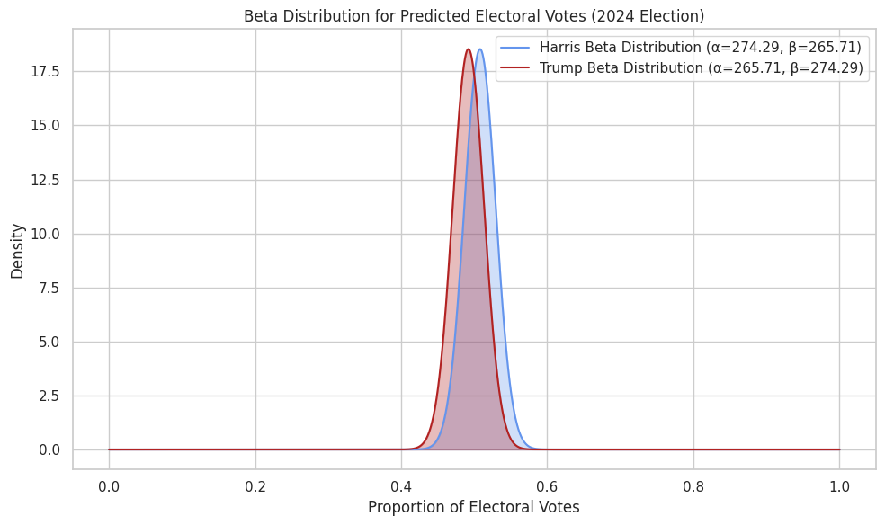
Bayesian Modeling to Predict 2024 Outcomes
Why Bayesian Modeling?
Bayesian models are well-suited for election forecasting because they allow us to combine prior data (2020 results) with current evidence (2024 polling), adjusting predictions as new data emerges.
Model Approach:
We use a Beta distribution to simulate the probability of each candidate winning based on weighted averages of historical votes and recent polling data.
Visualization:
Beta Distribution Visualization: This chart displays probability distributions for each candidate’s chances of winning, demonstrating how different weights (for polling vs. historical data) affect these probabilities.
Key Takeaway:
The Bayesian approach provides flexibility in adjusting for recent polling and makes probabilistic estimates of each candidate’s success in the 2024 election.
Notes:
Bayesian modeling was applied to predict the 2024 election outcome. The Bayesian approach was chosen because it effectively integrates prior information (e.g., 2020 election results) with current polling data for 2024, allowing predictions to adapt dynamically as new data is introduced.
The model used a Beta distribution to estimate the probability of each candidate winning. The Beta distribution is well-suited for this scenario because it can easily model probabilities that adjust as new polling data comes in. Parameters α (alpha) and β (beta) were derived from the number of electoral votes each candidate could win, weighted by historical and current polling data.
The Beta distribution visualization displayed the probability densities for both Harris and Trump in the 2024 election. The parameters for the Beta distributions were α = 274.29, β = 265.71 for Harris, and α = 265.71, β = 274.29 for Trump. These values indicate how the combination of historical voting trends and recent polling data influenced the shape of each distribution.
The Beta distribution curves highlight the uncertainty in the model’s predictions. The overlapping regions between Harris and Trump suggest a highly competitive election outcome. The density peaks represent the most likely proportion of electoral votes each candidate could secure. Harris has a slightly higher peak than Trump, indicating a marginal lead when considering both historical and polling data.
The visualization also shows the flexibility of the Bayesian approach to adjust weights between prior data and current evidence. For swing states and regions with recent fluctuations, the polling data was given more weight, resulting in broader distributions that capture the uncertainty in voter sentiment.

Slide 9
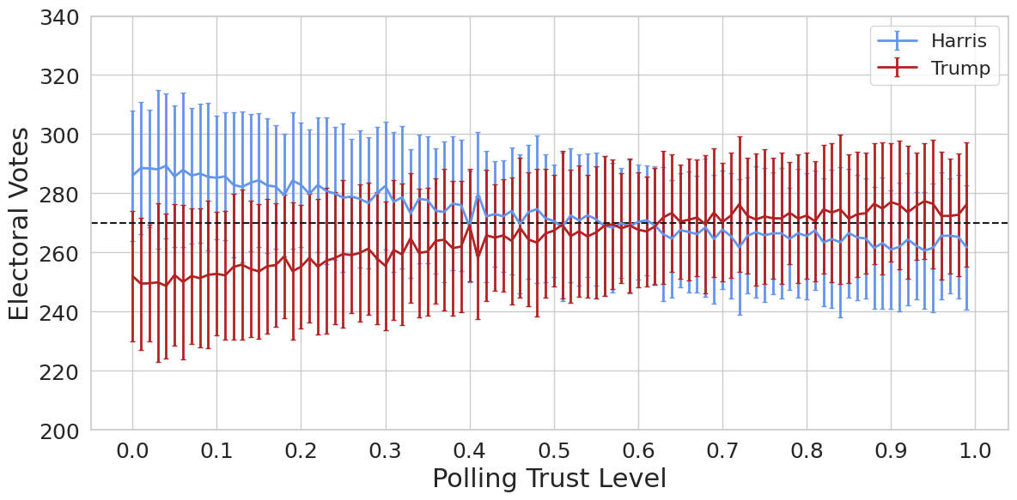
Results of Model Simulations
The model conducts multiple simulations with varying weights on historical and polling data to capture possible outcomes under different scenarios:
Simulation Details: Each scenario varies the emphasis on 2020 election results vs. current polling, reflecting the uncertainty of swing states.
Scenario Analysis: Scenarios that heavily weight recent polling data favour candidates currently leading in the polls, while those focusing on historical data predict outcomes closer to 2020 results.
The goal is to explore how different levels of trust in historical voting patterns vs. current polls might affect predictions about who would win the electoral vote count in a future election scenario.
Notes:
The model simulations were conducted to understand the impact of different levels of trust in historical voting data versus current polling. By varying the weights on 2020 election results and 2024 polling data, the model explored multiple possible election outcomes under different assumptions.
Each simulation scenario adjusted the balance between historical data and polling. For example, weights near 0.0 represented a heavy reliance on 2020 election results, while weights near 1.0 focused more on 2024 polling data. This allowed the model to explore a range of outcomes that accounted for both voter stability and the variability seen in polling data.
The graph shows how the electoral votes predicted for each candidate change with different levels of polling trust. Harris is represented by the blue line, and Trump by the red line. The error bars represent the standard deviation of electoral votes across simulations, indicating the degree of uncertainty in the prediction.
At lower polling trust levels (left side of the graph), the model heavily relied on 2020 results. Harris generally had higher electoral votes in these scenarios, reflecting the historical outcome. As the trust in polling data increased (moving to the right side of the graph), Trump's predicted electoral votes showed an increase, highlighting the influence of recent polling trends.
Swing states played a crucial role in these simulations due to their historical variability. The wide error bars at different trust levels indicate the model's uncertainty, particularly in swing states, where recent polling data and historical trends are often in conflict.
The dashed line at 270 electoral votes marks the threshold needed to win the election. The graph shows that as polling trust increases, both candidates hover around the 270 mark, illustrating how polling data could sway the outcome in either direction depending on voter behavior leading up to the election.

Slide 10
Conclusion and Future Work
Summary:
Bayesian model effectively combines historical and recent polling data for U.S. election forecasting.
Swing states remain highly competitive and are crucial to the model’s projections.
Next Steps:
Further Refinement: As new polling data emerges, the model can be re-run to provide updated probabilities.
Event-based Polling: Incorporate adjustments for events such as debates and significant political announcements.
Ongoing Visualization: Map results dynamically as more polls are added.
Ensemble Model: We plan to run an ensemble of models, such as linear regression, random forests, CatBoost, and XGBoost, particularly for swing states. By tuning hyperparameters across these models, we aim to enhance the final prediction of vote share and improve accuracy.
Final Observation: Bayesian modeling with a dynamic weighting system provides an adaptable and robust framework for predicting election outcomes. Its reliance on polling adjustments enables real-time reflection of changing voter sentiments. By simulating various scenarios, the study aims to offer a comprehensive view of potential electoral outcomes, highlighting the importance of both historical context and current voter sentiment in shaping election forecasts.

